Slide 1

Unveiling Market Insights: Analysing Spending Behaviour and Identifying Opportunities for Growth

Slide 2
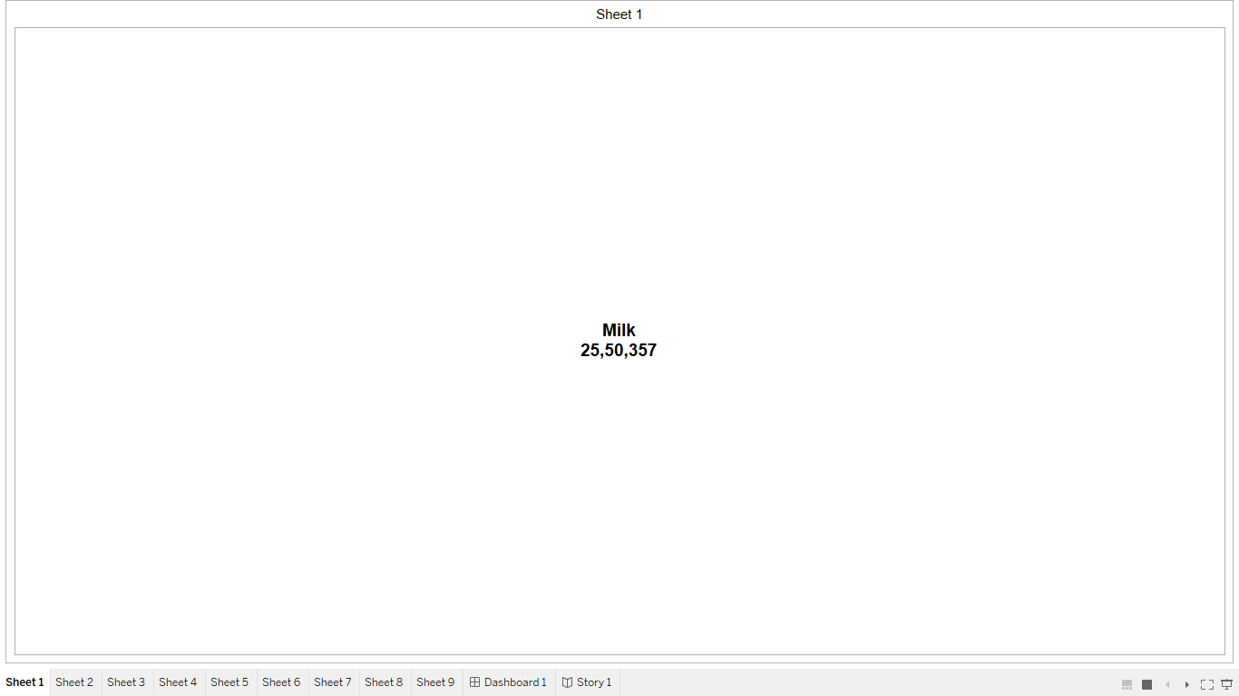
Milk

Slide 3
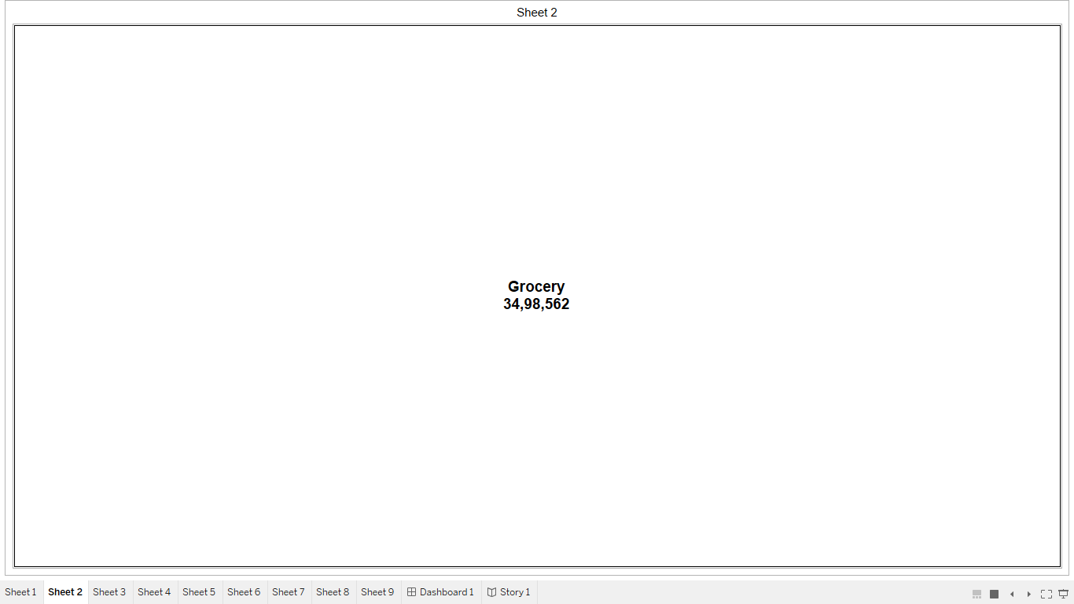
Grocery

Slide 4
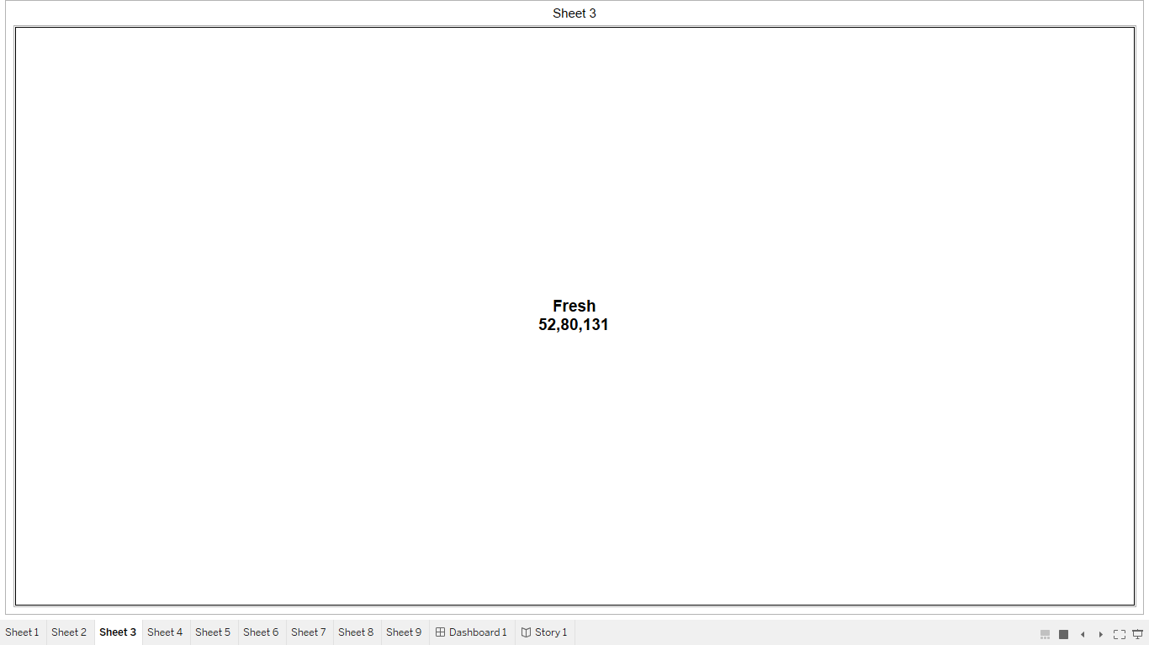
Fresh

Slide 5
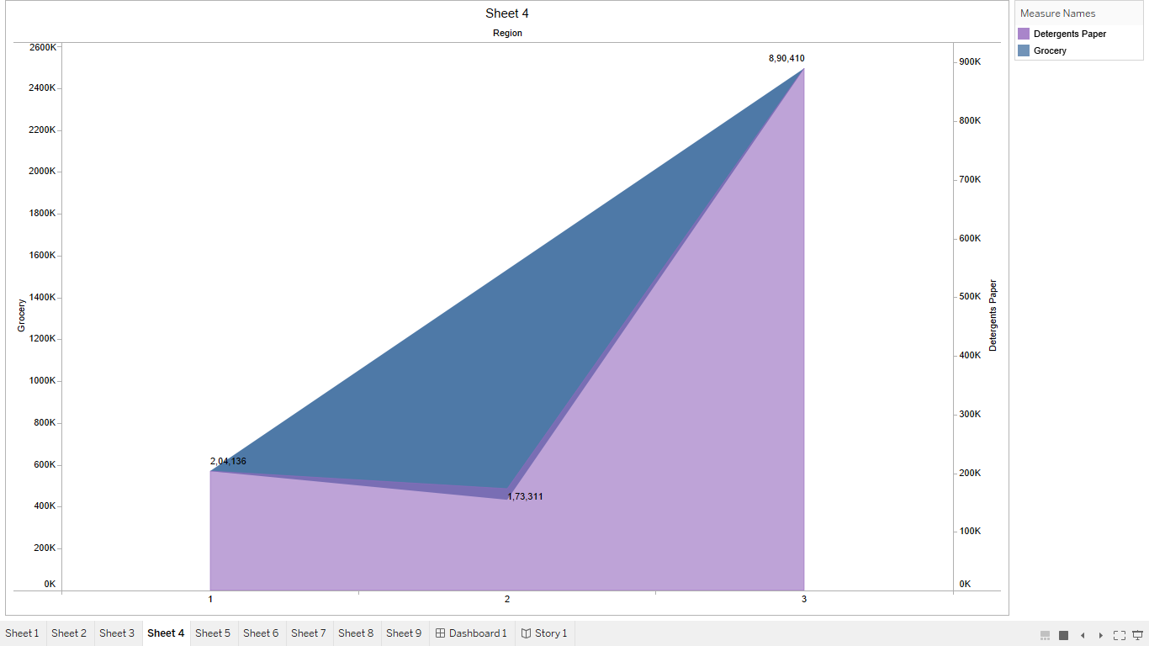
Region wise Detergent paper and Grocery

Slide 6
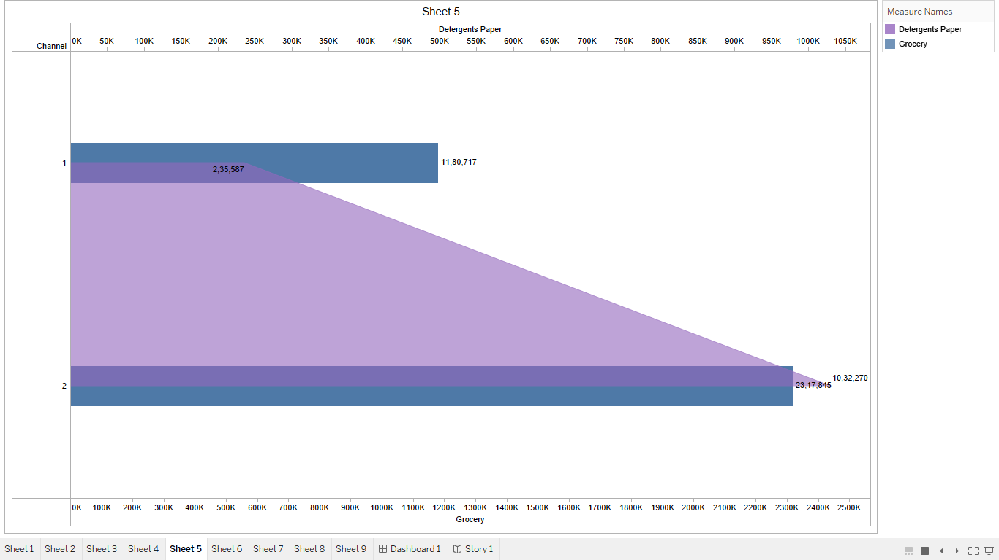
Channel wise Detergent paper and Grocery

Slide 7
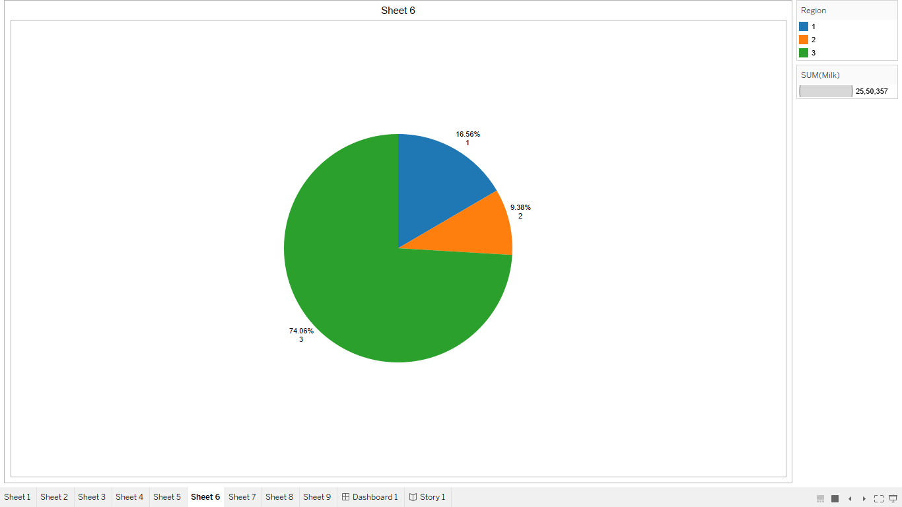
Region wise Milk

Slide 8
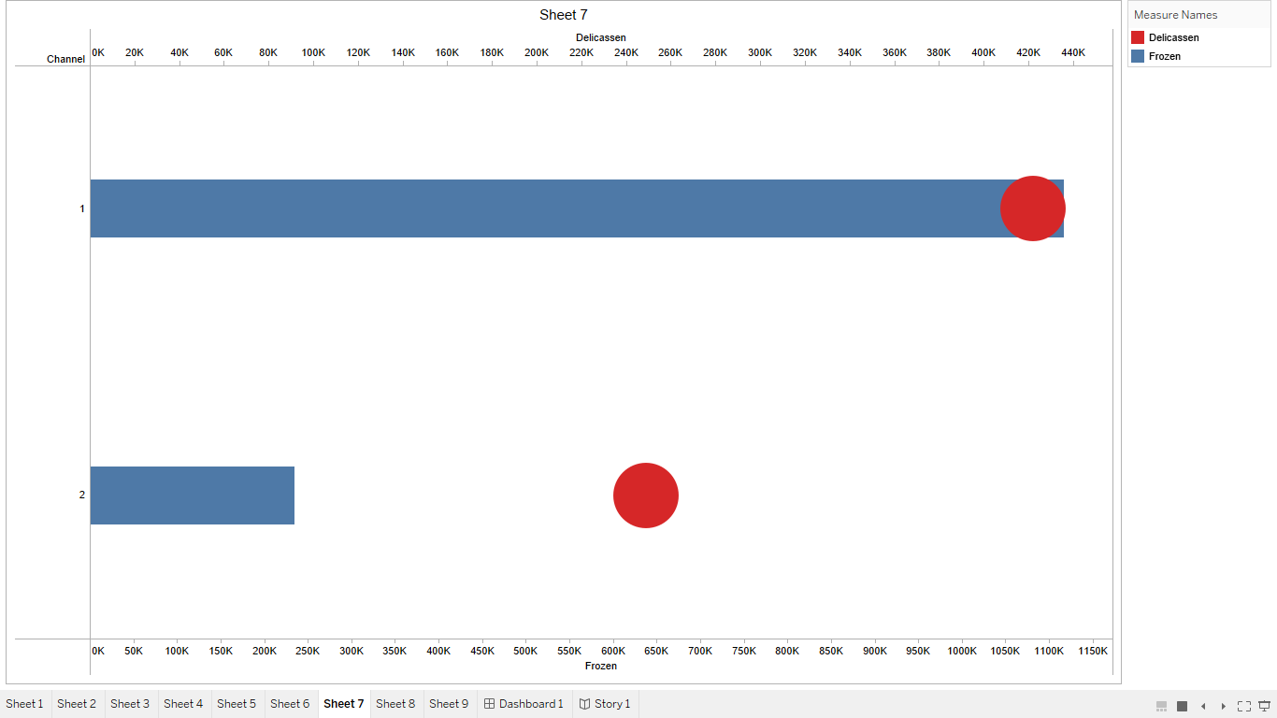
Channel Wise Delicassen and Frozen

Slide 9
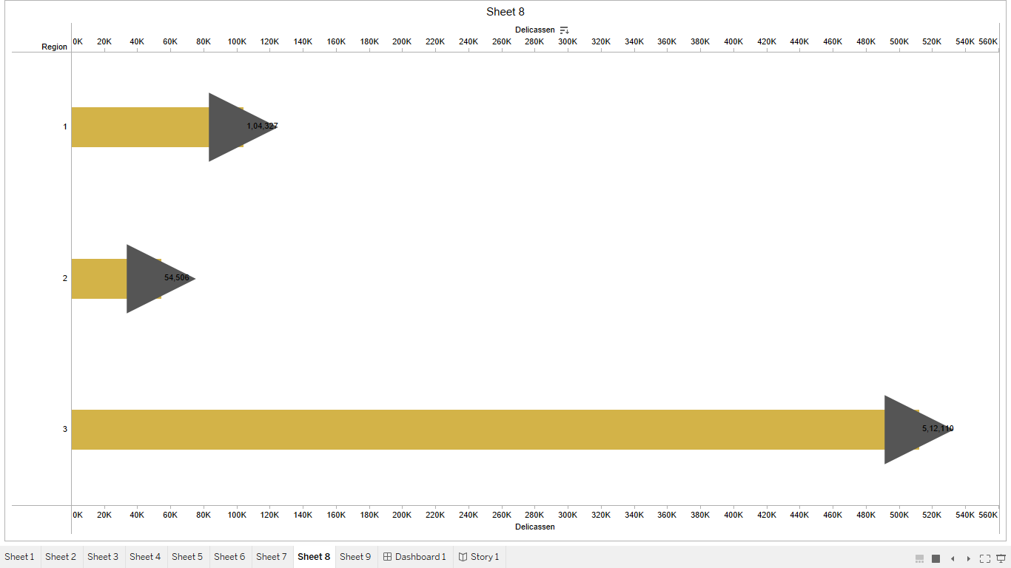
Region wise Delicassen

Slide 10
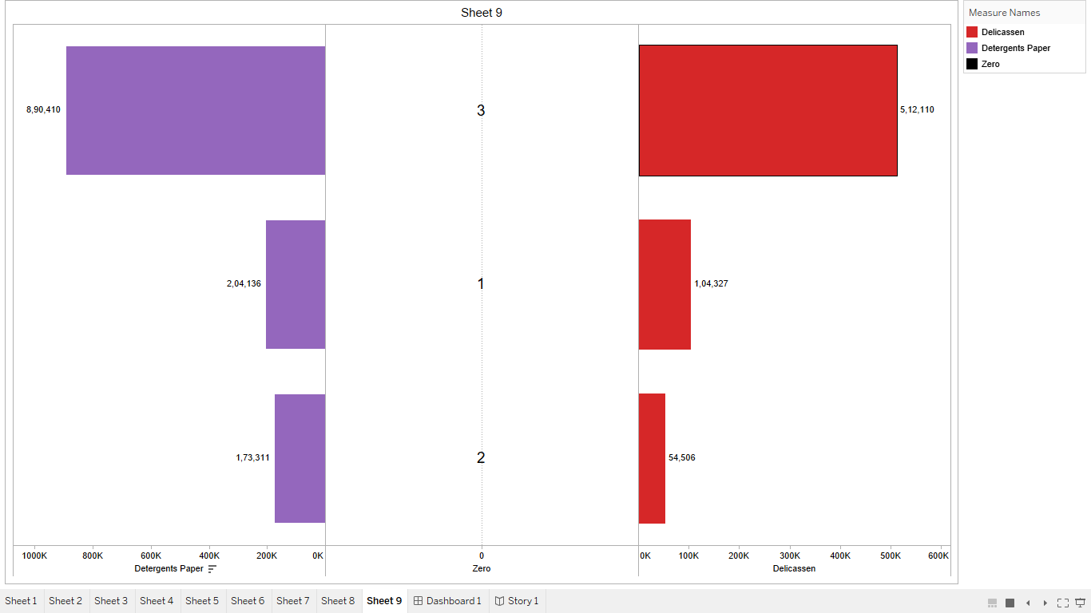
Region wise Delicassen and Detergent paper

Slide 11
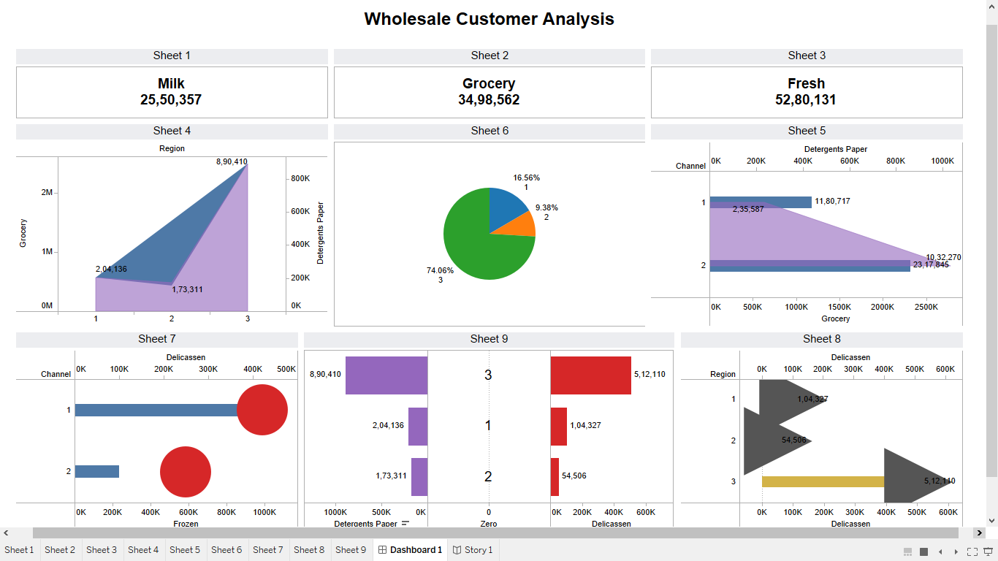
Wholesale Customer Analysis

Slide 12
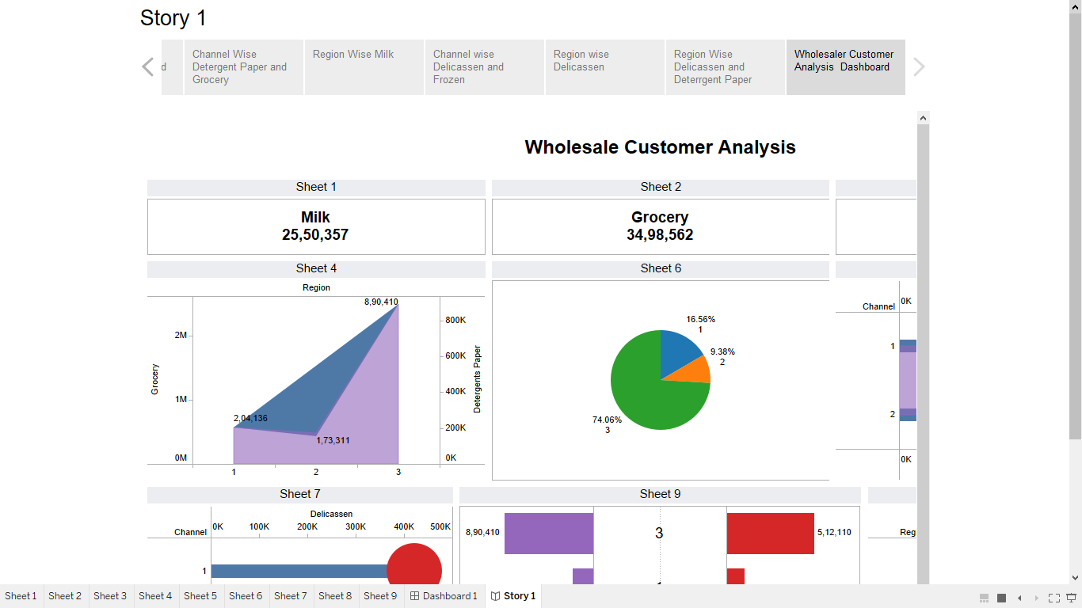
Story

